Slide 1
BC Code Review Final Presentation
Christina Nguyen, Sarah Ramazani, Michael Bloomquist, Travis Lamb

Slide 2
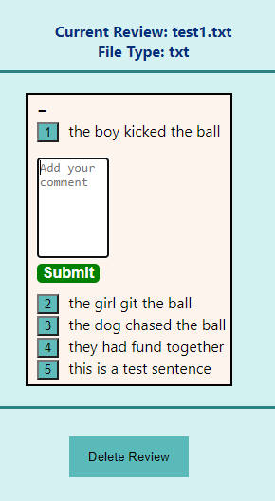
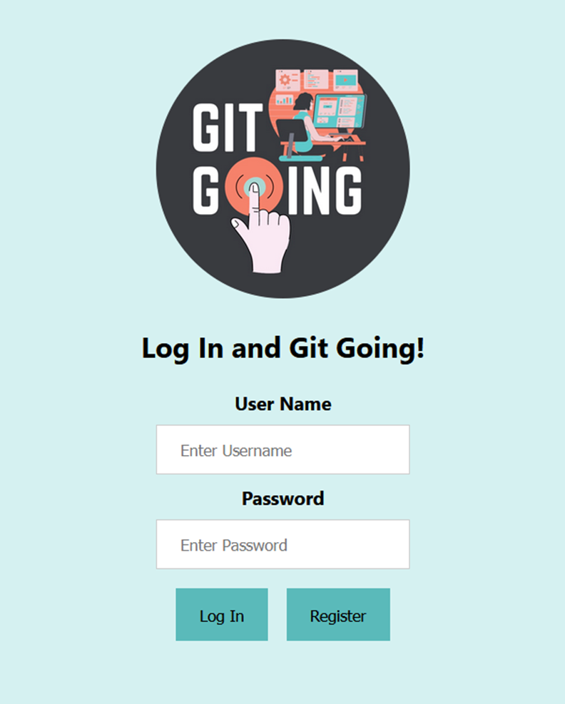
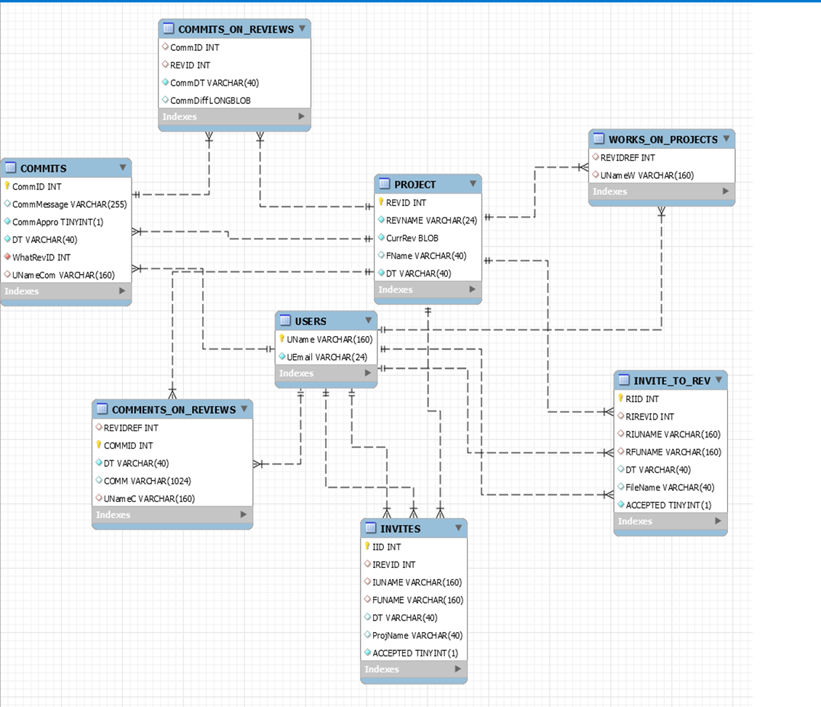
Where we were
Authentication System
Simple Email Service
Simple Queue Service
Database System
File Contents
User Information
Inline Commenting

Slide 3
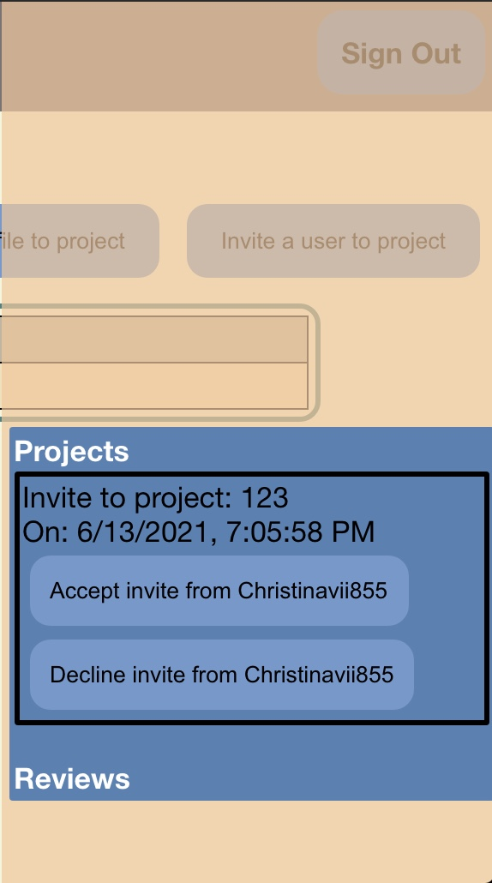
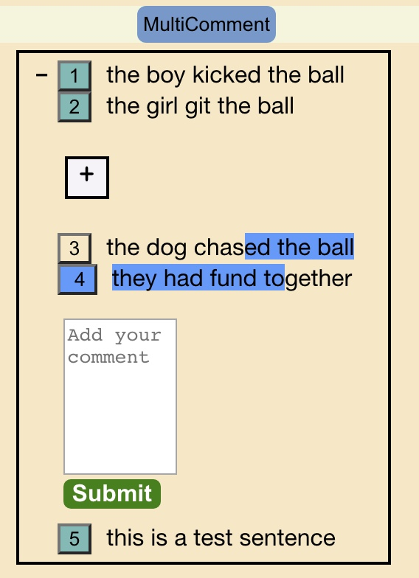
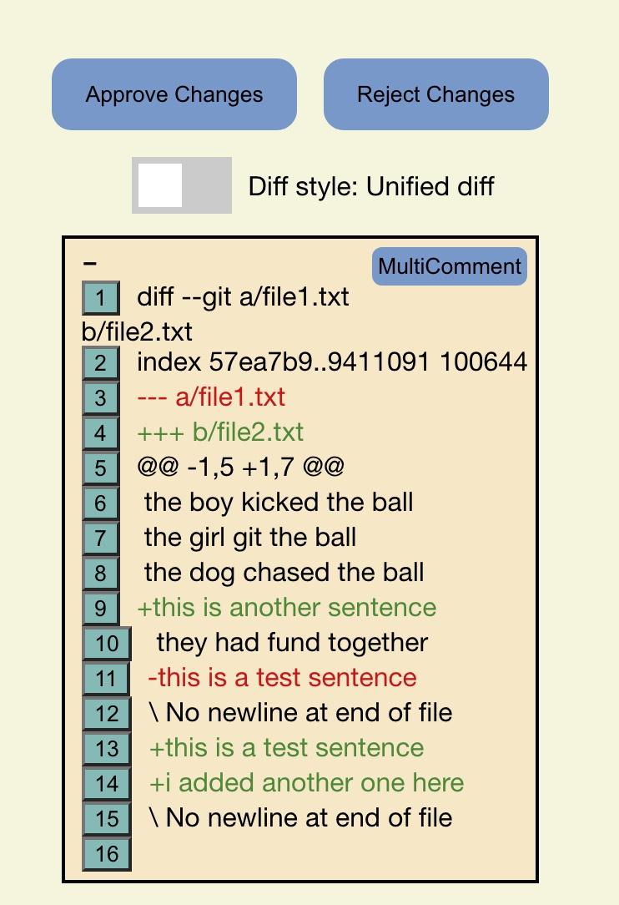
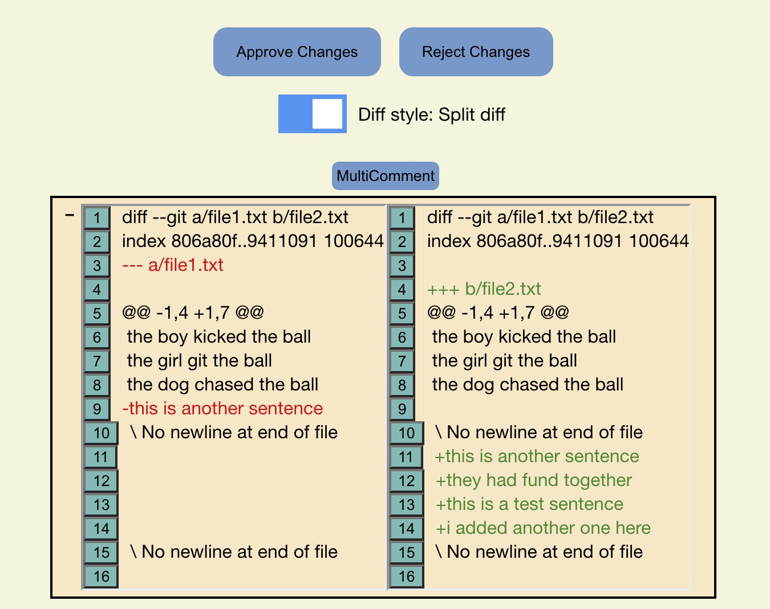
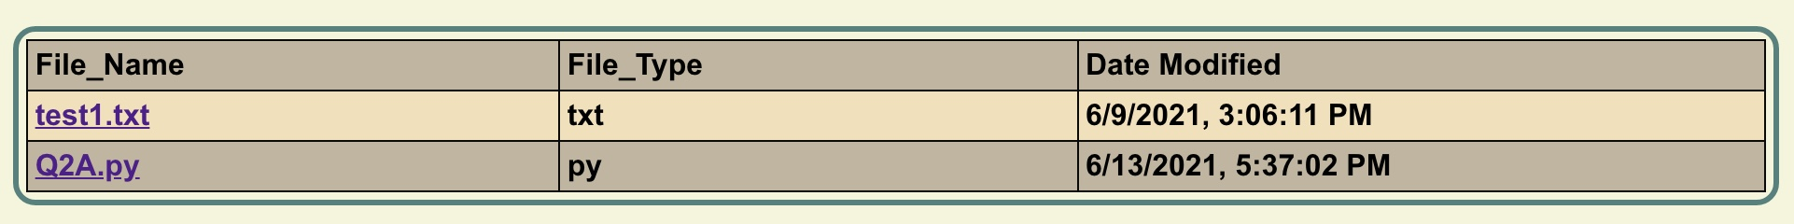
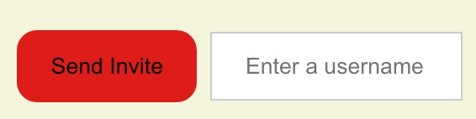
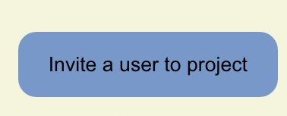


Where we are
Automatic retrieval of diffs when a file is updated
Implementation of the approval/rejection system for reviews
Implementation of file history for projects
Multiline commenting
Notifications

Slide 4
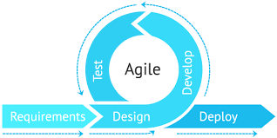
How we got there
Understanding of React components
Storing Comments in Database
Flask app to retrieve diffs
CSS Redesigning
Trial and Error

